Slide 1
Work on Multiple Table
Subquery

Slide 2



Using a Subquery to Solve a Problem
Who has a salary greater than Abel’s?
Main query:
Which employees have salaries greater than Abel’s salary?
Subquery:
What is Abel’s salary?
Notes:
Using a Subquery to Solve a Problem
Suppose you want to write a query to find out who earns a salary greater than Abel’s salary.
To solve this problem, you need two queries: one to find how much Abel earns, and a second query to find who earns more than that amount.
You can solve this problem by combining the two queries, placing one query inside the other query.
The inner query (or subquery) returns a value that is used by the outer query (or main query). Using a subquery is equivalent to performing two sequential queries and using the result of the first query as the search value in the second query.

Slide 3
Subquery Syntax
SELECT select_list
FROM table
WHERE expr operator
(SELECT select_list
FROM table);
The subquery (inner query) executes before the main query (outer query).
The result of the subquery is used by the main query.
Notes:
Subquery Syntax
A subquery is a SELECT statement that is embedded in the clause of another SELECT statement. You can build powerful statements out of simple ones by using subqueries. They can be very useful when you need to select rows from a table with a condition that depends on the data in the table itself.
You can place the subquery in a number of SQL clauses, including the following:
WHERE clause
HAVING clause
FROM clause
In the syntax:
operator includes a comparison condition such as >, =, or IN
Note: Comparison conditions fall into two classes: single-row operators (>, =, >=, <, <>, <=) and multiple-row operators (IN, ANY, ALL).
The subquery is often referred to as a nested SELECT, sub-SELECT, or inner SELECT statement. The subquery generally executes first, and its output is used to complete the query condition for the main (or outer) query.

Slide 4
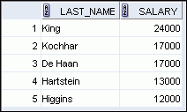
Using a Subquery
SELECT last_name, salary
FROM employees
WHERE salary >
(SELECT salary
FROM employees
WHERE last_name = 'Abel');
11000
Notes:
Using a Subquery
In the slide, the inner query determines the salary of employee Abel. The outer query takes the result of the inner query and uses this result to display all the employees who earn more than employee Abel.

Slide 5
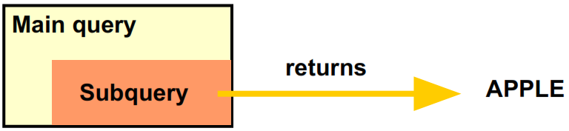
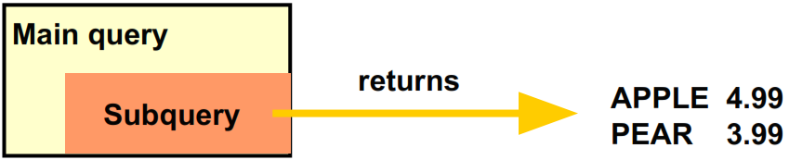
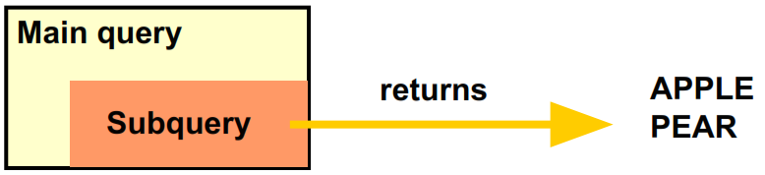
Types of Subquery
Single Value
Multiple Value, many rows and columns
Multiple Value, many row but one column

Slide 6
Apa yang dihasilkan dari subquery ini
SELECT *
FROM enrolment
WHERE mark > (SELECT avg(mark)
FROM enrolment
GROUP BY unit_code);
A. A value (a single column, single row).
B. A list of values.
C. Multiple columns, multiple rows.
D. None of the above.

Slide 7
Apa yang dihasilkan dari subquery ini
SELECT *
FROM EMPLOYEES
WHERE SALARY IN (SELECT MAX(SALARY)
FROM EMPLOYEES
GROUP BY DEPARTMENT_ID)
A. A value (a single column, single row).
B. A list of values.
C. Multiple columns, multiple rows.
D. None of the above.

Slide 8
Single-Row Subqueries Comparation
Return only one row
Use single-row comparison operators
Operator
Meaning
=
Equal to
>
Greater than
>=
Greater than or equal to
<
Less than
<=
Less than or equal to
<>
Not equal to
Notes:
Single-Row Subqueries
A single-row subquery is one that returns one row from the inner SELECT statement. This type of subquery uses a single-row operator. The slide gives a list of single-row operators.
Example:
Display the employees whose job ID is the same as that of employee 141:
SELECT last_name, job_id
FROM employees
WHERE job_id =
(SELECT job_id
FROM employees
WHERE employee_id = 141);

Slide 9
Multiple-Row Subqueries Comparation
Return more than one row
Use multiple-row comparison operators
Operator
Meaning
IN
Equal to any member in the list
ANY
Must be preceded by =, !=, >, <, <=, >=. Compares a value to each value in a list or returned by a query. Evaluates to FALSE if the query returns no rows.
ALL
Must be preceded by =, !=, >, <, <=, >=. Compares a value to every value in a list or returned by a query. Evaluates to TRUE if the query returns no rows.
Notes:
Multiple-Row Subqueries
Subqueries that return more than one row are called multiple-row subqueries. You use a multiple-row operator, instead of a single-row operator, with a multiple-row subquery. The multiple-row operator expects one or more values:
SELECT last_name, salary, department_id
FROM employees
WHERE salary IN (SELECT MIN(salary)
FROM employees
GROUP BY department_id);
Example:
Find the employees who earn the same salary as the minimum salary for each department.
The inner query is executed first, producing a query result. The main query block is then processed and uses the values that were returned by the inner query to complete its search condition. In fact, the main query appears to the Oracle server as follows:
SELECT last_name, salary, department_id
FROM employees
WHERE salary IN (2500, 4200, 4400, 6000, 7000, 8300, 8600, 17000);

Slide 10
Berapa row yang dihasilkan dari QUERY ini?
SELECT *
FROM EMPLOYEES
WHERE SALARY IN (SELECT MAX(SALARY)
FROM EMPLOYEES
GROUP BY DEPARTMENT_ID)
A. 1 Row
B. 13 Rows
C. 28 Rows
D. None of the above.

Slide 11
Berapa row yang dihasilkan dari QUERY ini?
SELECT *
FROM EMPLOYEES
WHERE SALARY > ANY (SELECT AVG(SALARY)
FROM EMPLOYEES
GROUP BY
DEPARTMENT_ID)
A. 1 Rows
B. 92 Rows
C. 107 Rows
D. None of the above.

Slide 12
Berapa row yang dihasilkan dari QUERY ini?
SELECT *
FROM EMPLOYEES
WHERE SALARY > ALL (SELECT AVG(SALARY)
FROM EMPLOYEES
GROUP BY DEPARTMENT_ID)
A. 1 Rows
B. 92 Rows
C. 107 Rows
D. None of the above.

Slide 13
Buat Query untuk menjawab pernyataan berikut
“Ada berapa employees yang salary nya kurang dari salary para staff di department “IT_PROG”)”

Slide 14
Another types of Subquery
Berdasarkan cara kerjanya
NESTED
Subquery tidak terpengaruh oleh main query (independent), dan hanya dijalankan satu kali
CORRELATED
Subquery depend on outer query, dan akan dijalankan di setiap row yang ada di outer query
INLINE Subquery masih menjadi satu kesatuan dengan main query dan dijalankan bersama dengan proses main query

Slide 15
SUBQUERY (NESTED)
Mencari EMPLOYEES yang salary nya melebihi salary rata-rata seluruh employees
SELECT *
FROM EMPLOYEES
WHERE SALARY < (SELECT AVG(SALARY) FROM EMPLOYEES)

Slide 16
SUBQUERY CORRELATED
Mencari employee yang salarynya melebihi salary managernya
select emp.EMPLOYEE_ID, emp.FIRST_NAME, emp.MANAGER_ID, emp.SALARY
from EMPLOYEES emp
where emp.SALARY > (select Salary
from EMPLOYEES man
where man.EMPLOYEE_ID = emp.MANAGER_ID);
CHECK
select EMPLOYEE_ID, salary
FROM EMPLOYEES
where EMPLOYEE_ID in (148,149)

Slide 17
SUBQUERY INLINE
Mencari EMPLOYEES yang salary paling tinggi di departmentnya masing-masing nya
SELECT emp.EMPLOYEE_ID, emp.first_name, emp.last_name, emp.DEPARTMENT_ID, emp.SALARY
FROM (SELECT DEPARTMENT_ID, MAX(SALARY) as max_salary
FROM EMPLOYEES
GROUP BY DEPARTMENT_ID) as MAX_TABLE
INNER JOIN EMPLOYEES EMP
ON EMP.DEPARTMENT_ID = MAX_TABLE.DEPARTMENT_ID
AND EMP.SALARY = MAX_TABLE.max_salary

Slide 18
Buat Query untuk menjawab pernyataan berikut
“Ada berapa employees yang mulai bekerja lebih dulu dari managernya? Lebih senior dibanding managernya”

